Slide 1
Agenda item 9
Improving Freedom to Speak Up (FTSU)
Board of directors 25 May 2023

Slide 2
Report title | Improving FTSU at Moorfields
Report from | Sheila Adam, Chief Nurse and Director of Allied Professionals
Prepared by | Sheila Adam, Chief Nurse and Director of Allied Professionals
Link to strategic objectives | This work links to Working together - we will collaborate with one another as individuals, in our teams, with our patients and our partners

Slide 3
Executive summary
Freedom to Speak up is an essential part of building a more open culture, in which leadership encourages learning and improvement. It leads to:
safer care and treatment
improved patient experience
greater staff satisfaction and performance
The Board is aware of and prioritises the importance of this open culture and improving freedom to speak up and supports our staff to:
feel confidence to speak up
feel that speaking up will result in change
feel that speaking up will not result in disadvantage
The Peer review report in January 2023 identified areas for improvement for Moorfields including structure, culture and processes. We have built an improvement delivery plan in response to this, working on a co-created approach to review of the model with our staff, development of training for managers and staff, and building enhanced data with triangulation to support reporting.
Ongoing FTSU work continues with 30 concerns raised to our current guardians between January and March 2023

Slide 4
Quality implications As above, an open learning and improvement culture improves patient and staff satisfaction and the ability to achieve excellence in care
Financial implications No specific financial implications.
Risk implications Failure to support improvement in freedom to speak up will impact on patient and staff satisfaction and the quality of care
Action required/recommendation The Board is asked to endorse the approach to improving freedom to speak up
For assurance |  | For decision |  | For discussion | X | To note | X

Slide 5
Improving Freedom to Speak Up at Moorfields
Sheila Adam, Chief Nurse and Director of Allied Professionals
May 2023

Slide 6
Contents
The importance of Freedom to Speak Up (FTSU) at Moorfields
Peer review of our current FTSU arrangements
Working to establish and embed a culture of confidence in speaking up
Delivering Improvements
Notes:
Martin
Mobilised the XDU to support the delivery of the portfolio

Slide 7
The importance of FTSU at Moorfields
1
Notes:
Martin
Mobilised the XDU to support the delivery of the portfolio

Slide 8
The importance of FTSU at Moorfields
The Board believe that FTSU is vitally important in our values of excellence, equity and kindness. A more open culture encouraging learning and improvement leads to:
It leads to:
  safer care and treatment
  improved patient experience
  greater staff satisfaction and performance
We must support our staff to:
      feel confidence to speak up
      to feel that speaking up will result in change
      to feel that speaking up will not result in disadvantage
However, in recent NHS staff surveys a number of questions which are important to FTSU and the culture of the organisation have shown little improvement over the last 5yrs
A Peer Review of our FTSU arrangements was commissioned in November 2022. This was reported to the Board in January 2023
Source: Moorfields Eye Hospital NHS Foundation Trust 2022 NHS Staff Survey Benchmark Report, Survey Coordination Centre
Notes:
Key speaking up questions are either deteriorating or static

Slide 9

Peer Review findings January 2023
2
Review undertaken by Karan Wheatcroft, Director of Risk & Improvement and FTSU Executive Lead, Liverpool Heart and Chest NHS Foundation Trust
Notes:
Martin
Mobilised the XDU to support the delivery of the portfolio

Slide 10
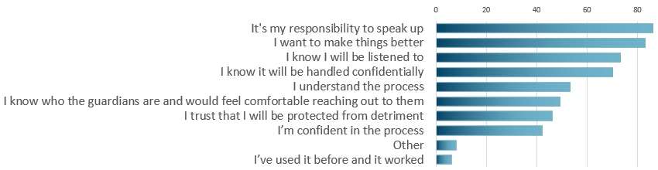
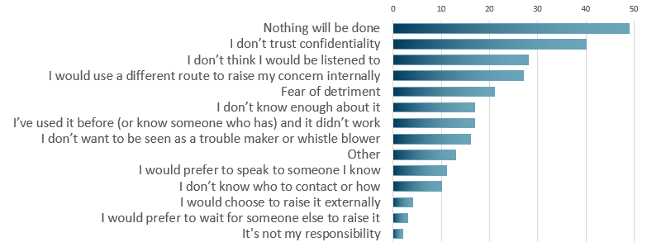
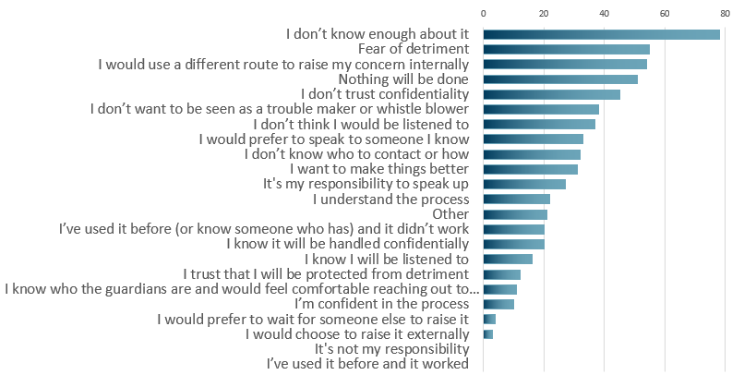
Snap Survey results
Yes
No
If you had a concern, would you use FTSU?
Maybe
There were 409 respondents to the survey that was issued as part of the review. They could select multiple responses for the reasons for electing their initial answer. The number of responses rose significantly when the communication confirmed anonymity.

Slide 11
Opportunities Identified for Improvement
Structure
Agree FTSU model
Introduction of Champions/ Ambassadors (support/nurturing of the network)
Ring fenced / dedicated resource
Clarity of roles and responsibilities, and measures against these
Open recruitment for the appointment of future FTSU Guardians
Culture
Alignment of FTSU with culture improvement priorities
Develop and deliver against a formal communications plan
Expand range of FTSU activities to augment site visits
Review findings regarding ‘barriers’ to speaking up and develop an action plan (e.g. comms priorities, structure, processes etc).
Demonstrate ongoing review of FTSU cases, outcomes and actions in terms of the bigger picture and opportunities to improve wider culture
Support and understanding for managers, to help FTSU Guardians in response and action.
Board commitment statement
Public Board reporting (once developed)
Processes
Review FTSU policy including flowcharts, escalation, signposting and roadmap
Regular meetings/ workshops with FTSU Guardians and Exec/NED leads (and champions if introduced to the model)
Board reporting and assurance (to include trends, analysis, outcomes, learning & triangulation)
Additional channels to raise concerns
Triangulation meetings (HR)
Executive team escalation and awareness of FTSU speak ups
Clear roles and responsibilities and how these work together
Single case log expanded to include learning and outcomes
Demonstrate use of wider intelligence, benchmarking and best practice

Slide 12
Delivering Improved Culture and FTSU at Moorfields
3
Notes:
Martin
Mobilised the XDU to support the delivery of the portfolio

Slide 13

Changing the way we support FTSU at Moorfields
Co-creation of revised FTSU model with staff
Culture Change is a Priority for the Board
Enhanced training:
Managers; all Staff; FTSU team
Monitoring effectiveness via multiple data sources
Focus groups and staff engagement
Statement of Board Commitment and support/resource
Regular reporting reflecting triangulation approach to Data
Induction training
Open and transparent change to FTSU model to fit multi-site organization and address barriers
NED and Exec walk abouts, increased visibility and involvement
Line Managers training
Public Board Reporting
Alignment with other organizational culture change
FTSU team training
Continuous review of improvement
Testing of Champions model
Effective communication about FTSU with staff through induction, feedback, IQ etc.
Reflecting Moorfields values – Excellence, Equity and Kindness

Slide 14
Ongoing monitoring of FTSU and the current Guardian model continues
30 concerns were raised to guardians in Q4 (1/1/2023 to 31/3/2023)
Theme | Primary | Secondary
Culture/Behaviour | 9 | 9
Process | 6 | 5
Training | 0 | 0
Patient Safety/quality/risk | 2 | 1
Staff safety/well-being | 13 | 6
Total | 30 | 21

